Slide 1
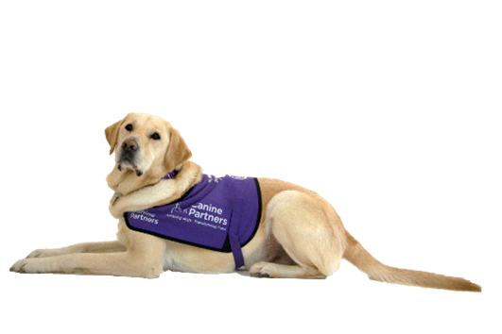

Manual Handling Guidance

Slide 2
Think before you lift
Task
What requires to be lifted / moved
What is the starting position of the item – is it on a table, above your head or at floor level
How far does it need to be moved
Where is it to be put at its destination - is that area/ surface clear and unobstructed
Ta
Individual
What are my capabilities / limitations
What are the capabilities / limitations of others assisting with the task
N.B These may change from day to day
Load
What is the nature of the load
What shape is it – how easy can you get a firm grip
Will carrying the load obscure your view
Will the load move around as you try to lift / move it
Environment
What is the ground like under foot, is there any risk of slipping or tripping – make sure your route is clear and unobstructed – open any doors that you need to pass through
Equipment
Is there a piece of equipment that you can use to reduce the risk of moving an item – if so have you been trained how to use this

Slide 3
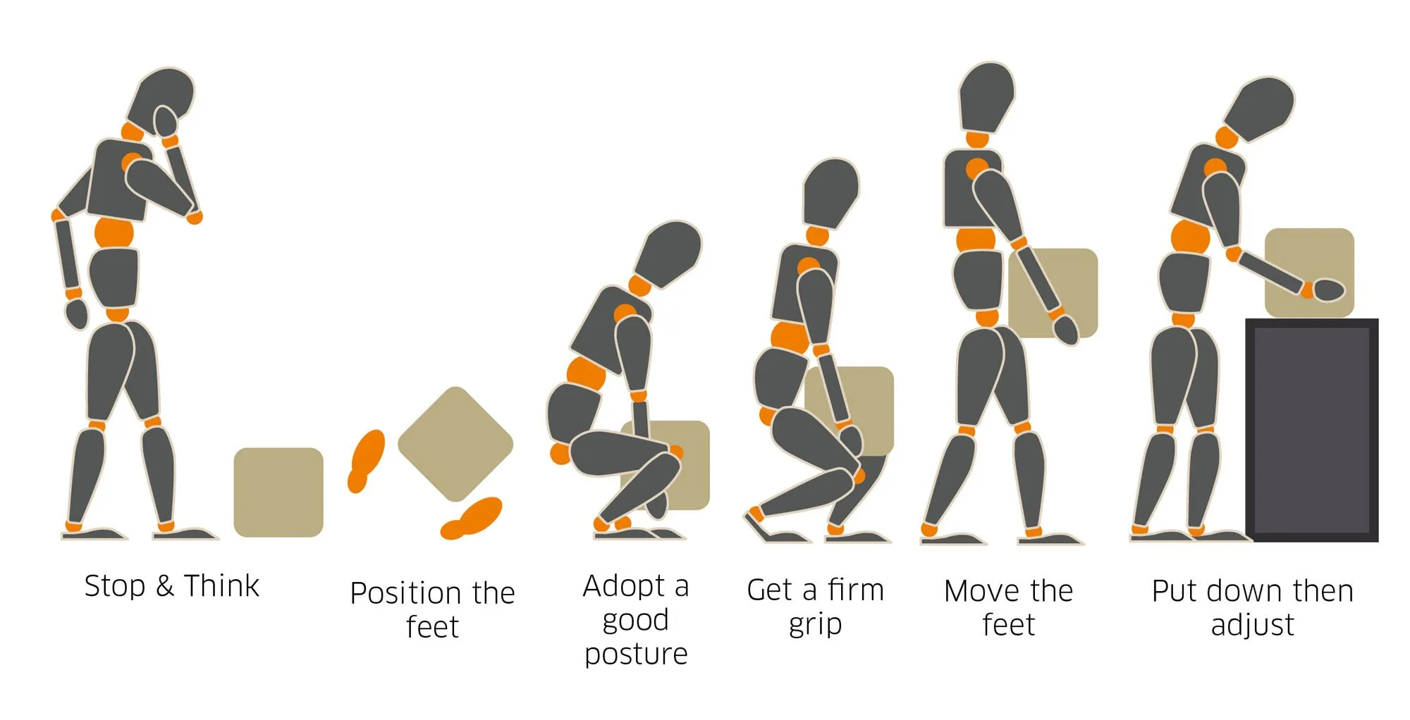
The 5 P’s of manual handling
Plan: Make a plan before you start.
Position: Approach the load evenly, with your feet about shoulder-width apart.
Pick: As you move the object upward, maintain a natural motion, keeping the load as close as possible to your spine.
Proceed: With caution.
Place: Place the object where you want it

Slide 4
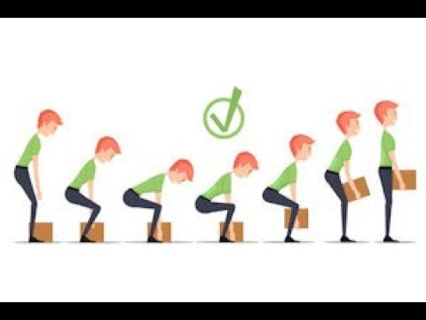
Bends ‘z’ knees
Assuming the item to be moved is at floor level
Position your feet either side of the item
Bend your knees
Grasp the item underneath
Raise at your knees and lift the item at the same time
Straighten your legs and back – keep the item close into your body
Keep the item close to your body and your arms straight as you carry the item

Slide 5
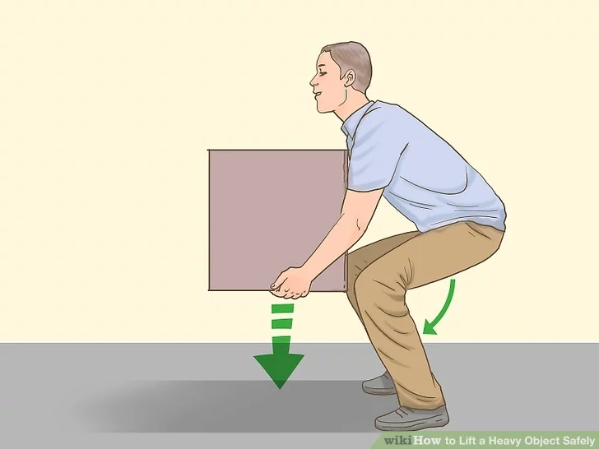
Putting the item down
When it comes to putting the item down on the floor the same applies
Keep you back as straight as possible and bend your knees
Gradually lower the item down
Remove your hands and then keep you back straight and raise from your knees into a standing position

Slide 6
Things to avoid
Twisting your body whilst bending, picking up, carrying or lowering an item
Stretching to reach items that are out of arms reach
Pulling or dragging items
Reaching above your head either to lifts something down or up

Slide 7
Lifting Dogs and Puppies
Dogs or Puppies may need to be lifted for a variety of reason and doing so presents its own risks. As with any lifting you should consider your own capabilities / limitations in relation to the size and weight of the dog / pup to be lifted
If a dog is injured or frightened then this can add to the risks associated in lifting it – special consideration must be made if it is suspected that an injured dog has spinal injury, fractures, abdominal or thoracic injuries in which case a two -person lift using a board or stretcher should be executed
With the exception of lifting a small puppy it is recommended to always seek assistance from another person before attempting the lift
When lifting a dog or puppy it is essential to make sure that they feel secure, this will lessen the likelihood that it wriggles and reduce the risk of it hurting you, or falling and hurting itself
Engage the same principles as lifting an inanimate oject ie: bending your knees and keeping the dog close to your body

Slide 8
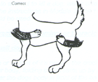
Lifting Dogs and Puppies
Small dog or puppy – single person lift
Place one arm around the dog’s neck or shoulder, folding the forearm by flexing the elbow.
Pull the upper part of the dog’s body firmly against your chest.
Place the opposite arm under the dog’s body, behind the back legs,
by pulling the elbow inwards, hold the dog’s stifle/knee area;
Firmly hold the dog’s body against yours.

Slide 9
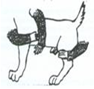
Lifting Dogs and Puppies
Large dog or puppy – two person lift
One person stands at the dog’s shoulder with one arm curled around the front of the chest/shoulder, holding the dog/puppies head against the handler’s shoulder, to give additional control.
The second arm is passed under or over the chest.
The second person stands at the hindquarters and holds the dog/puppies stifles (knees) or supports the pelvis.
Communication between the two lifters is important for a safe and comfortable lift.

Slide 10
People
No – one should attempt to lift another person
In the event that a person has fallen it may be appropriate having ascertained that the fallen person is not injured to assist them to raise from the floor
In the case of our partnerships who fall regularly they may have their own techniques to get up. In this case, if you feel comfortable doing so then you may be able to help them to get themselves off the floor using their techniques – communication is the key and don’t ever be afraid to say no if you think that they or you are at risk of getting injured through the process
If you do decide to help someone get up then ALWAYS ask another person to be present to ensure safe- guarding of all concerned

Slide 11
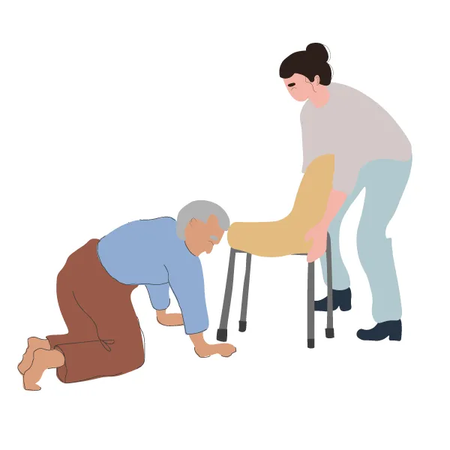
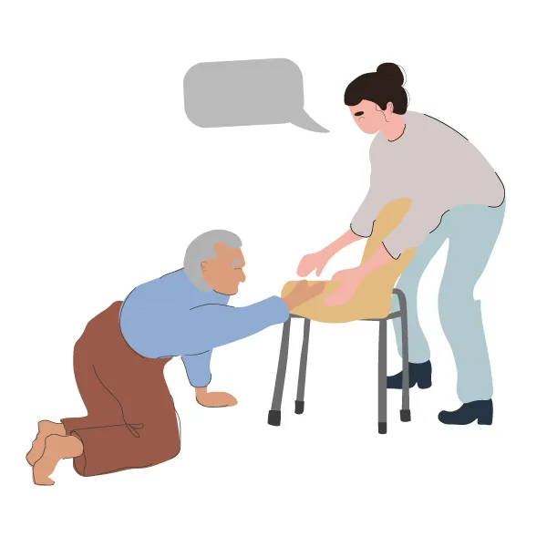
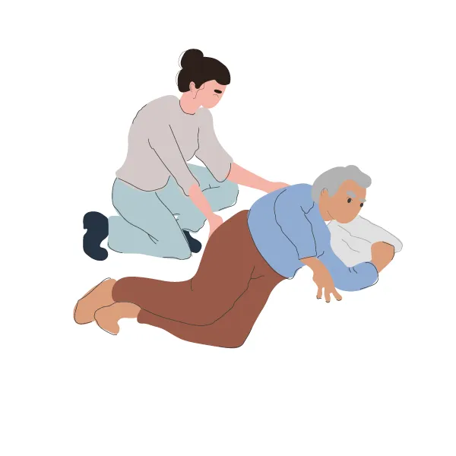
Using the 2 chair technique
Stage 1 – having ensured the person is uninjured and happy to attempt to get up, encourage them to roll on one side - they should roll their head and shoulders towards they way they wish to roll and then the hips and legs to follow in the same direction – ask them to rest a moment in this position
Stage 2
Support them to come into a ‘dog’ position kneeling equally on both knees with their hands flat on the floor
Stage 3
Bring a stable, non wheeled chair in front of them and encourage them to grip this firmly with both hands

Slide 12
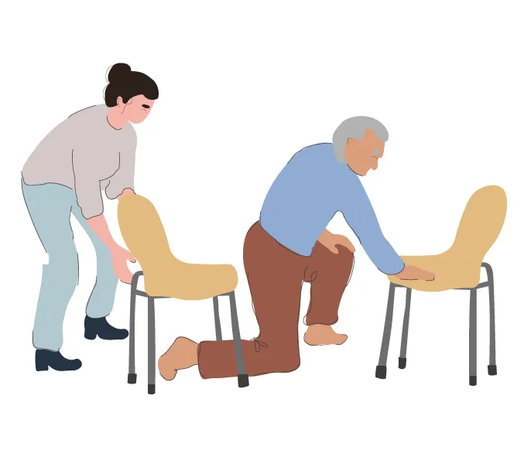
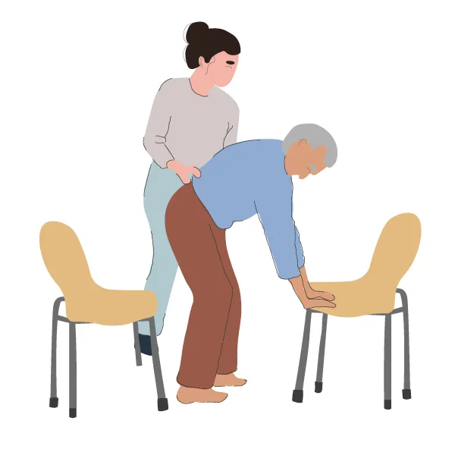
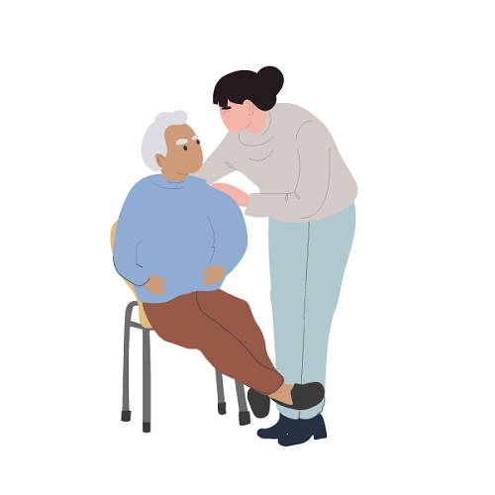
Using the 2 chair technique
Stage 4
Bring a second chair behind them, encourage them to ‘push up’ on the chair in front and at the same time push themselves into a ‘standing position still supporting themselves on the front chair
Encourage them to rest before gradually sitting back into the chair behind them
You can help by, once they are ‘standing,’ bringing this rear chair closer to them – guide them to sit into this chair
Encourage them to rest to recover from the shock and activity
If at any time it becomes they are apparent help them to get comfortable and treat for injuries

