Slide 1


Healthy Driving

Slide 2
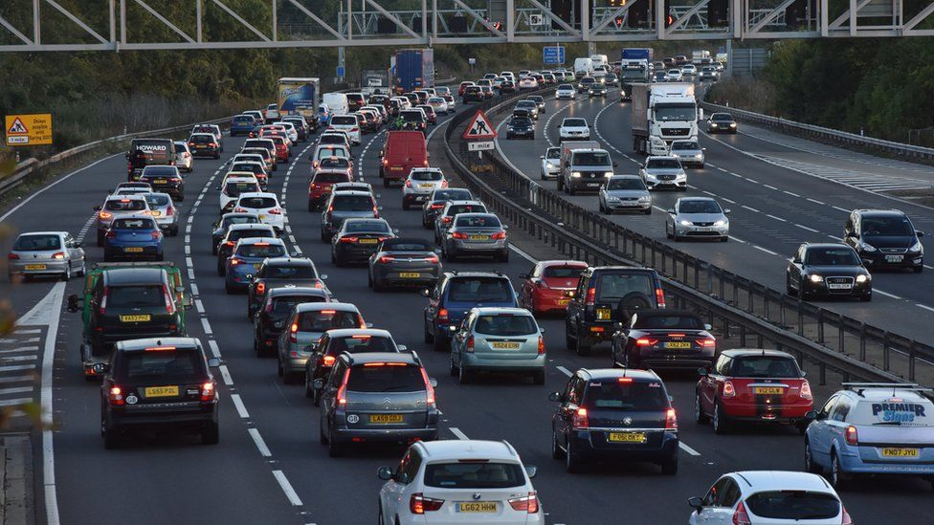
Potential health impacts from long distance or repetitive driving
Back, neck and shoulder pain
Mental and emotional strain – causes tension which impacts physical health
Soft tissue/ repetitive strain injury
Fatigue and sleepiness – increased risk
of accident
Hip and knee pain
Eye strain, headaches especially from
Driving in bad weather, poor light or bright sunlight
Impaired circulation leading to discomfort and ‘pins and needles’

Slide 3
How to reduce negative health impacts of regular driving
Prepare for journeys - being prepared reduces stress and tension which impact your physical health
Get a good amount of rest, eat well and get and stay hydrated
Ensure your vehicle is prepared – check fuel and water levels and tyre pressure, clean windows, number plates and lights
Set up your vehicle – seats, mirrors etc – see notes later
Make the interior of your car a pleasant place to be – keep your car clean and clutter free
Use the sat nav or your phone to plan your route and take into account the time of day, day of the week and any holidays, road works etc. that may affect your travelling time
During the journey
Eat regularly and keep hydrated during your trip – this will avoid dips in blood sugar levels and reduce the risk of losing focus and concentration
Take regular breaks – get out of the car stretch out and relax – it is recommended 15 minutes break every 2hrs
Change position within the driving seat eg: if you aren’t changing gear don’t sit with your foot on the clutch
Use the cars ‘technology’ eg: cruise control, to make the journey easier and more relaxed

Slide 4
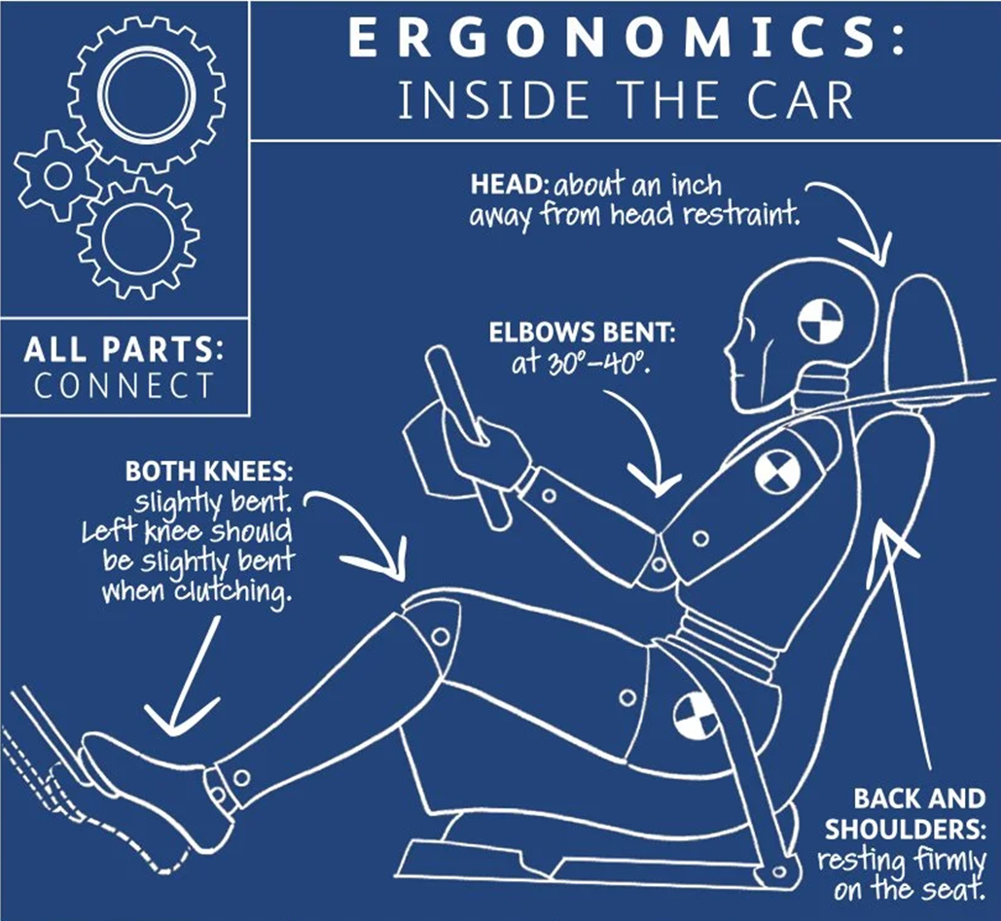
Positive posture
Your upper back should be firmly against the seatback, which should be at an angle of 100-110 degrees. Your bottom and hips cradled into the seat
The head should naturally sit about an inch from the head rest which should be adjusted so that it is as high as the top of your head
Your knees should be slightly bent when pressing the pedals.
The seat should be far enough from the steering wheel. This allows your arms to bend at a 30 – 40 degree angle.
Your palms should rest comfortably on top of the wheel with arms extended although when actually driving you should aim to hold the wheel at approx. 9 and 3
Diagram from the Chartered society of Physiotherapist

Slide 5
Setting up your seating position
If you are unsure how to adjust the elements discussed below refer to the vehicle handbook
Before you begin set ..
Steering wheel fully up and forward.
Seat as low as possible.
Seatbase tilted so the front edge is in its lowest position (if applicable).
Seatback is approximately 30 degrees reclined from vertical.
Lumbar adjustment fully backed off.
Whole seat as far back as possible
Stage 1
Raise the height of the seat until you are seated comfortably and have a good clear view of the road ahead
Ensure that you still have headroom and your head is not brushing or touching the roof liner
Stage 2
Move the seat forward until you can comfortably reach the pedals remembering that your knees should be slightly bent when actually driving
Ensure that the seat height is still correct as above

Slide 6
Setting up your seating
Stage 3
Adjust the tilt of the seat base to provide good support under the thighs without putting pressure behind the knees
Stage 4
Adjust the seatback so it provides continuous support along the back up to the shoulders 100 - 110 degrees from the base should be about right
Avoid an overly reclined position: this will cause excessive forward bending of the head and neck and may force you to slide forward on the cushion.
Stage 5
If there is a lumbar support adjust it to ensure even pressure is applied along the length of the seatback.
Ensure lumbar support fits your back and is comfortable, with no pressure points or gaps.
Stage 6
Adjust steering wheel reach so that the palms on your hands rest on top of the wheel when you straighten your arms (don’t lean or stretch forward) Move the wheel down until you have a clear view over the top without elongating your neck.
Check there’s adequate clearance for thighs and knees when using pedals.
Ensure dash display is in full view and not obstructed by the wheel.

Slide 7
Setting up your seating
Stage 7
Adjust the head restraint so the top is level with the top of your head.
Check there is a maximum of two inches between the front of the restraint and the back of
your head.
Stage 8
Adjust seatbelt height so it runs across your chest and lower abdomen
Stage 9
Adjust the external, and if appropriate internal, mirrors to give you good all round vision of the road
You will need to do this every time you drive a different car or a shared pool car

Slide 8
Mistakes to avoid
Sitting too close to the steering wheel, this will make you feel cramped and tense, increase your tendency to ‘stare’ out at the road and in the event of an accident increases your risk of injury from the air bag
Reclining too far back. This can lead to neck strain and reduces your ability to see clearly the road around all sides of your vehicles .
Hunching forward: This puts unnecessary stress on your back and neck. It can also worsen the impact from your seatbelt in the event of an accident.
Gripping the steering wheel too tightly: This can cause tension in your hands, arms and shoulders. It can even carry upwards to your neck.

Slide 9
Tips for a more comfortable journey
Take Regular Breaks: Stop every 2 hours to stretch and move around.
Stay Hydrated: Drink water regularly, but avoid excess caffeine.
Adjust Your Position: Make small changes to your sitting position every 15-20 minutes.
Use Cruise Control Wisely: It can help on long stretches, but not in heavy traffic.
Wear Comfortable Clothing: Choose loose, breathable fabrics.
Maintain Proper Temperature: Keep the car interior between 68-72°F (20-22°C).
Pack Healthy Snacks: Bring easy-to-eat, nutritious options.
Plan Your Route: Know where rest stops are located.
Check Tire Pressure: Properly inflated tyres provide a smoother and safer ride.
Protect Your Eyes: Use sunglasses and visors to reduce eye strain.

Slide 10
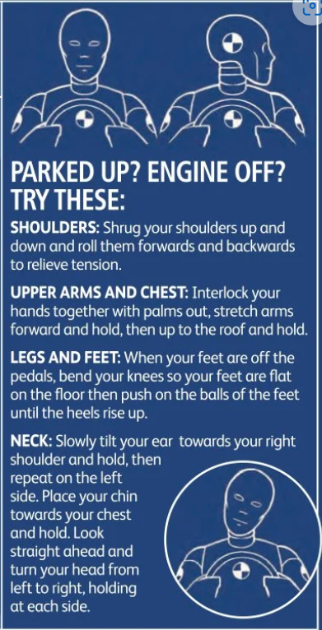

Stopped at the lights?
Try these stretches
Chin tuck
Rest your head back on the head rest.
Gently tuck your chin in.
Nod your chin downwards.
Aim to feel a stretch at the back of your neck.
Hold for 3-5 seconds.
Scapular retraction
Squeeze your shoulder blades together.
Aim to feel the muscles between your shoulder blades contract.
Hold for 3-5 seconds
Pelvic tilt
Gently tilt your pelvis forwards.
Aim to feel a firm contraction in the muscles in the lower back.
Relax
Stretch it out

Slide 11
Sources
https://boostphysio.com/wp-content/uploads/2016/11/driving-ergonomics.jpg
https://activeman.com/driving-ergonomics
www.whatcar.com/news/the-perfect-driving-position/n13482
Information from the chartered society of Physiotherapy
https://www.motorfinity.uk/blog/ergonomics-in-car/
www.posturedirect.com/9-tips-to-improve-your-posture-whilst-driving/

